Slide 1

MINOR PROJECT-II CRICKET FANTASY LEAGUE WEBSITE
Under the guidance of: Mr. B. Suresh
Submitted by:
Kumar Vatsal 9918102011 E1
Divyanshu Tomer 9918102027 E1
Palash Kulshrestha 9918102032 E1

Slide 2
PROPOSAL OUTLINE
KEY DISCUSSION POINTS
Introduction
Objective
Problem Statement
Technology Used
Work Progress
Architecture of the Methodology Used
Features Used
Website Screenshots
Future Scope
Learning Outcome
Conclusion
References

Slide 3
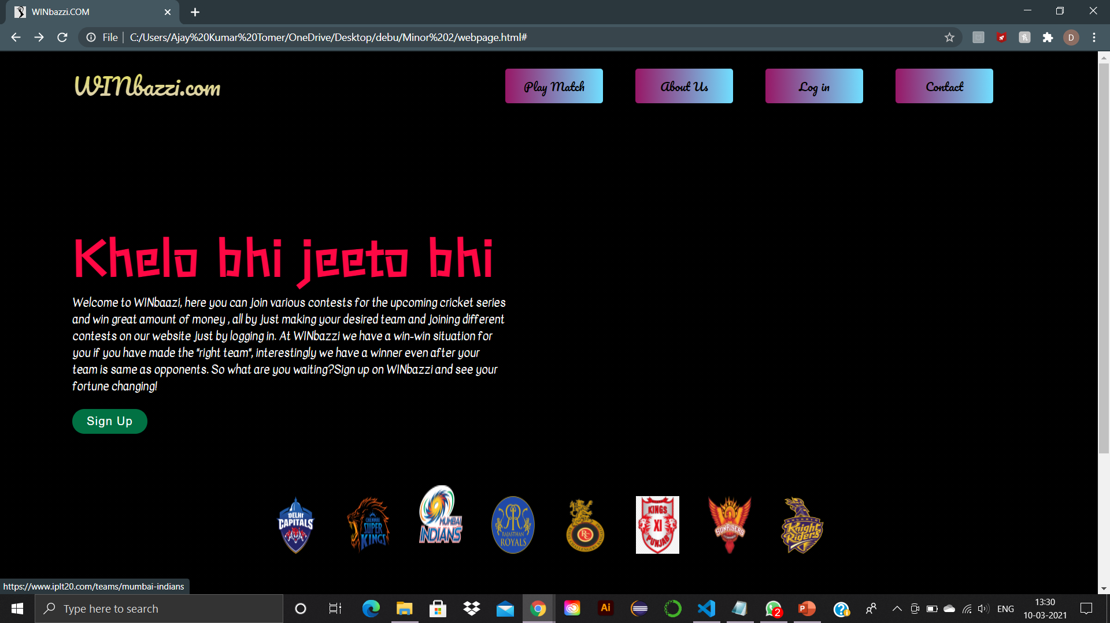
INTRODUCTION
Cricket Fantasy League is a game of skill where you create a team of real players for an upcoming match within 100 credits.
We have designed a ‘Cricket Fantasy League’ website which provides the users with a platform that allows them to play Fantasy Cricket and win money.
We have named the site as “WINbazzi”.

Slide 4
AIM OF OUR PROJECT
1st
We want to make our website with latest features and also work on some ideas which can attract users as those ideas will make our website different from the popular ones.
2nd
To add on the latest and unique features and present the website in real world can gain us popularity and success.
3rd
To develop a reliable point system.

Slide 5
PROBLEM STATEMENT
The other popular fantasy league websites such as Dream11 , Myteam 11 etc are popular but they lag behind when it comes to the fact that when two or more players in a contest have same points then how to decide the winner with pure logical and unbiased ways.
Other fantasy league websites do not take Super overs into consideration.

Slide 6
TECHNOLOGY USED
FRONT-END | BACK-END
HTML | NODE.JS
CSS, BOOTSTRAP | EXPRESS.JS
JAVASCRIPT | NODEMON

Slide 7


WORK PROGRESS
Landing / Home Page
Sign-Up/Log-In Page
Consists of the information about our website.
Login , Sign up and Contact buttons for user's help
All IPL teams logo with the feature which redirects the user to the official homepage of the selected team just by clicking on the team logo.
Users can visit our facebook , instagram and twitter pages for various updates just by clicking on the desired logo of the social media they want to access.
Users those who have signed up and made their account on our website can login through from here.
Options such as 'forgot password' and 'don’t have an account?' are placed on this page for easy user interface.

Slide 8
Architecture of the Methodology Used
www.WINbazzi.com
Landing / Home Page
Different team’s IPL Page
Sign-Up / Log-In Page
Competition Page
Back-end
Match Page
Your team page
Back-end

Slide 9
WEBSITE SCREENSHOTS
Fig 1 : Home / Landing Page

Slide 10
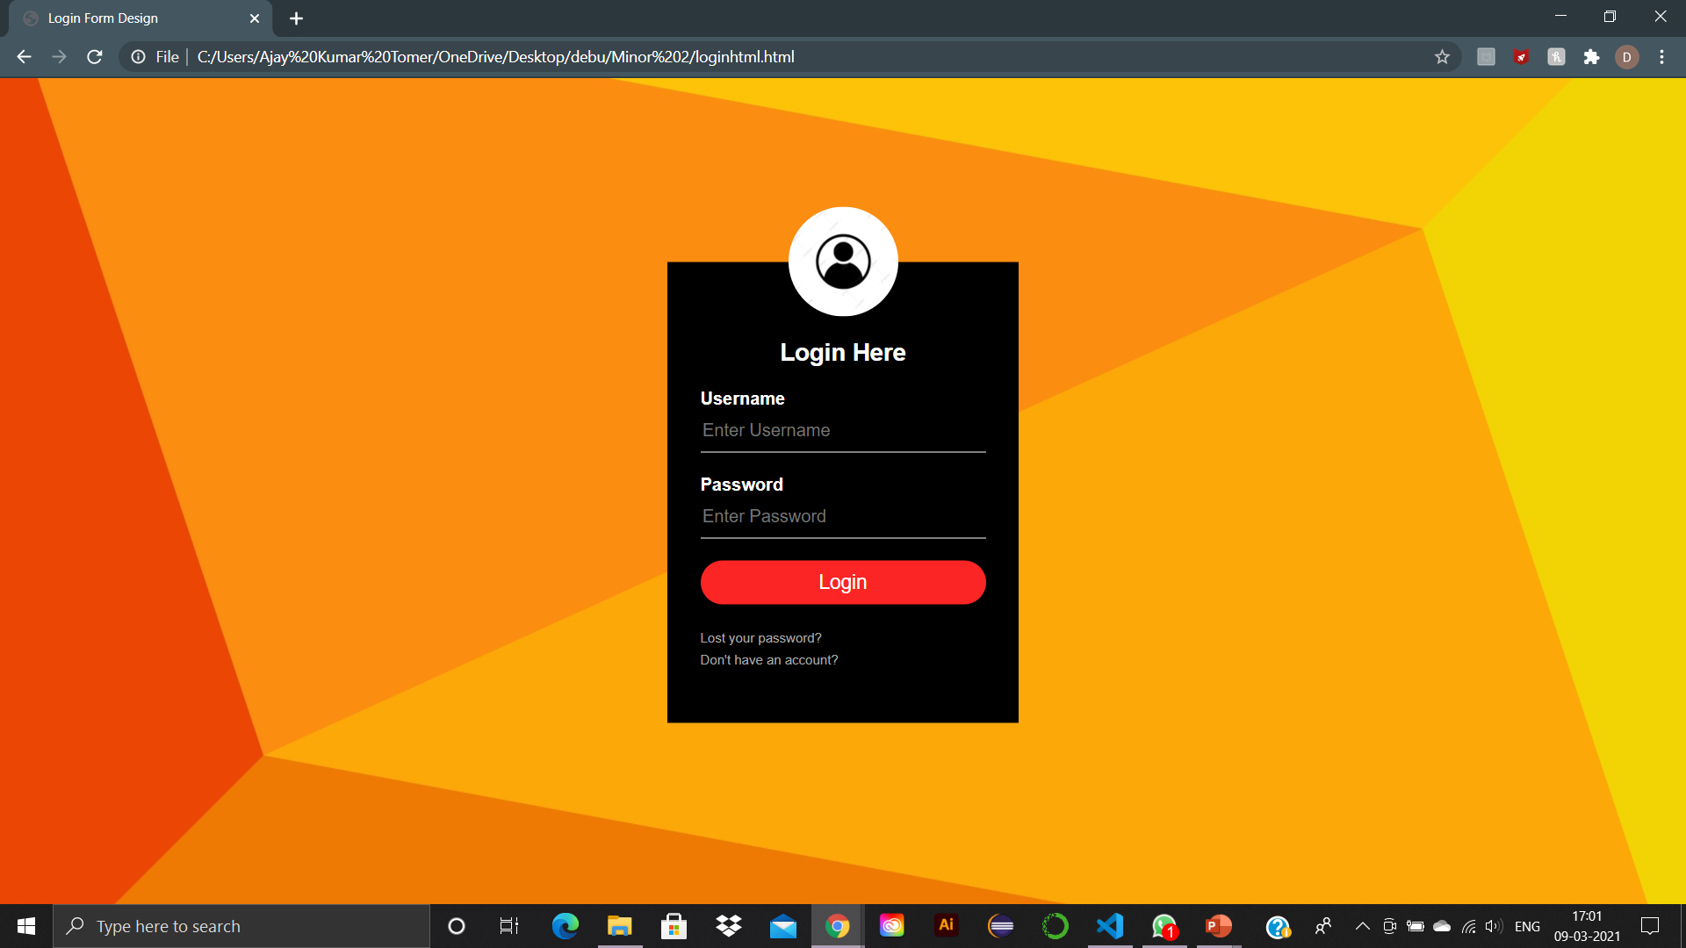
WEBSITE SCREENSHOTS
Fig 2: Log-In / Sign-Up Page

Slide 11
FUTURE SCOPE
www.WINbazzi.com
We have come across the web development technology through this project and the project has made web development , especially front end development of websites very much familiar and comfortable to us. It would be easy now to work on any such web development projects/assignments.
The very first and the most important scope of this project is to host the site under any domain and make the website live for users all around India.
The second important scope of this project is to add more games in our website for the users such as football , women cricket , basketball , design their fantasy point system and include multiple leagues for multiple sports to attract users of all sports genres

Slide 12
LEARNING OUTCOME
www.WINbazzi.com
We learned about how HTML , CSS and JavaScript is used in Front-end development.
We learned about functioning of a website.
We learned how to code in HTML ,CSS and JavaScript in Visual Studio Code.
Got familiar with the relationship between the internet and websites.

Slide 13
CONCLUSION
www.WINbazzi.com
The main aim of this project to create a unique and updated interface for our website in this modern era of various fantasy league websites and apps.
Also to provide a “reliable point system” to judge a winner.
And hence create popularity and trend.

Slide 14
REFERENCES
www.WINbazzi.com
Yongkang Xing , JiaPeng Huang , “Research and Analysis of the Front-end Frameworks and Libraries in E-Business Development” , 2019 11th International Conference , February 2019. https://www.researchgate.net/publication/332456776_Research_and_Analysis_of_the_Front-end_Frameworks_and_Libraries_in_E-Business_Development.
Udemy/ Complete Web-Development Bootcamp.
Youtube.

